Slide 1
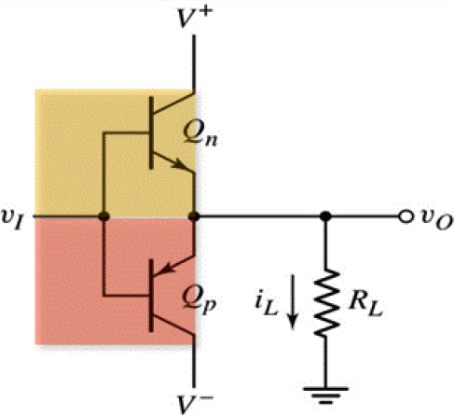
Quiz 6.1
Deadline: May 29, 2020
Question 1
The class B power amplifier is shown in the Figure. Given that two transistors are identical with V_{BE} = V_{EB} =0.7V, V⁺ = 20V, V⁻ = -20V, R_{L} = 8Ω and v_{I} is a sinusoid varying from -16V to +16V.
What is the peak voltage v_{o}?
Compute the power delivered to the load R_{L} assuming that the waveform can be considered as the sinusoid.
Compute average power drawn from each supply .
Compute the efficiency of the amplifier.
What is the disadvantage of class B amplifier

Slide 2
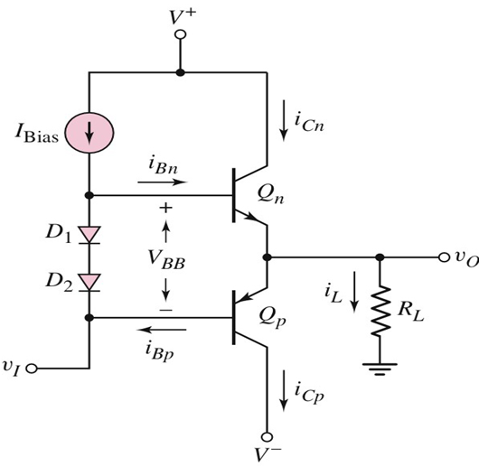
Question 2
The class AB power amplifier is shown in the Figure. Given that two transistors are complementary with i_{Cn} = i_{Cp} = 20mA corresponding to β = 50. Diodes D₁ and D₂ are identical with I_{S} = 10⁻¹⁴ A and n = 1.
Find V_{BB} If I_{Bias} = 10mA.
If R_{L} = 8Ω and load power is 10W, Give your suggestion about the value of V+ and V-.

